Slide 1
Information Technology Fundamentals
DT228/1
Tutorial 1 - IT Components
Thursday 22 September 2016

Slide 2
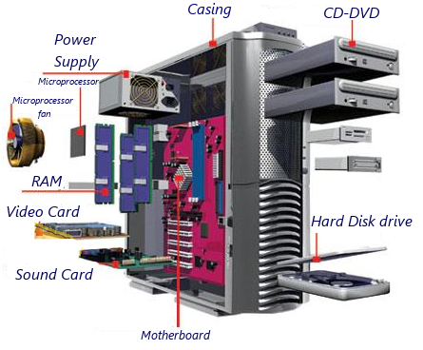
Hardware Parts
Does it matter in how a computer’s hardware parts are placed together?
YES. Many of the major components must be compatible.
Hardware engineering

Slide 3
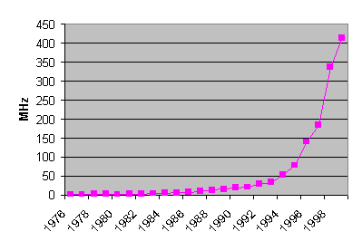
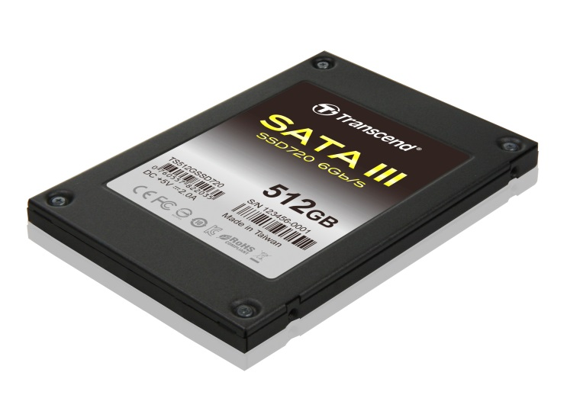
Hardware Development
All hardware manufacturers are continuously developing their hardware components.
Research and development.
CPUs – faster clock speeds every year.
Hard disks – greater capacity every year.

Slide 4
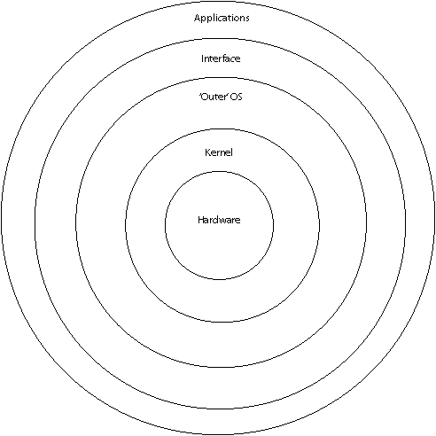
Users and Systems

Slide 5
Operating Systems Parts
Kernel: ‘fundamental software’ that provides the vital core functions needed to make the machine run, and to protect it.
Outer OS: other parts of the operating system that perform less critical functions.
Interface: e.g. GUI – graphical user interface. There is an overlap between applications and GUI – some GUI software is part of OS, ‘top part’ takes cues from applications.

Slide 6
Applications and OS
Applications: ‘task-specific’ software, from very simple to very complex tasks.
Do applications need operating systems?
Yes, because the OS takes the ‘burden’ of machine management processes (software) that are important for the application to function.

Slide 7
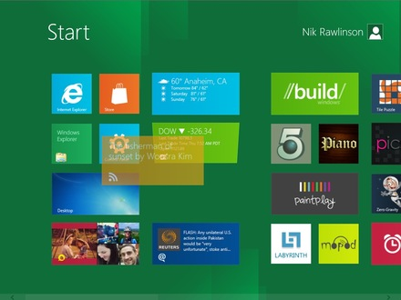
Windows 8
Windows 8 interface is Metro-based.
Quicker boot-up
Better memory management
Better speed
Better recovery
BUT
Tricky to negotiate apps.
Tablet-oriented (if you prefer PC or laptop).

Slide 8
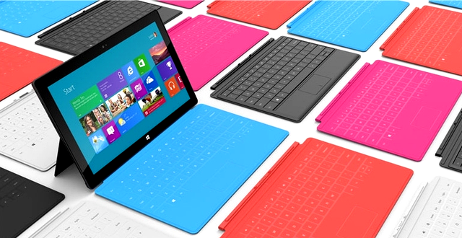
Surface Tablet and Windows 8 Combo

Slide 9
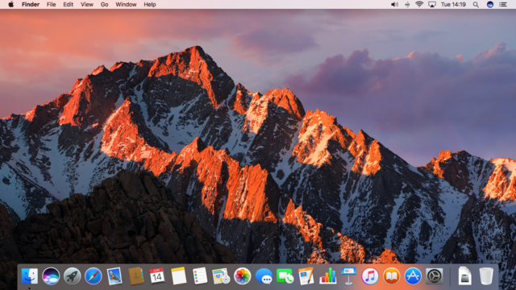
Mac OS X
This is OS X Sierra.
Major new features concern Continuity, iCloud, and windowing, as well as support for Apple Pay and Siri.
BUT
Can give slow performance through wifi, paricularly iTunes

Slide 10
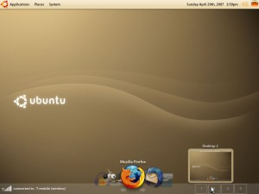
Ubuntu
Linux = ‘Linus’s Unix’ (Sort of)
Ubuntu = ‘Humanity to all people’

